Slide 1

MDCC
Health Science Programs
Dream Big . Plan Well.
Be Anything.

Slide 2

Health Sciences
The Health Science Division is comprised of the following Allied Health Programs: Dental Hygiene Technology, Medical Laboratory Technology, Radiologic Technology, Physical Therapist Assistant (Effective May 12, 2020, MDCC’s Physical Therapist Assistant Program has been granted Candidate for Accreditation status by the Commission on Accreditation in Physical Therapy), Phlebotomy and the following Nursing Programs: Associate Degree Nursing, Practical Nursing, and Health Care Assistant.
Students applying for admission into Health Science programs must meet the general college admission requirements. In addition, each program has individual requirements. Students wishing to apply to a specific program should consult the Policy of Admission to Health Science Programs and admission requirements specific to the individual program.

Slide 3

Allied Health Programs
Dental Hygiene Technology
Medical Laboratory Technology
Physical Therapy Assistant
Radiologic Technology
Phlebotomy

Slide 4
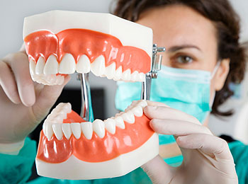
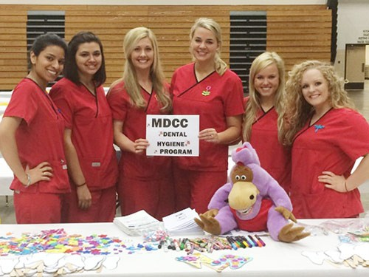
Dental Hygiene Technology
2 Year AAS Degree Program
Admission Requirements
18 ACT score (15 if taken before October 28, 1989) for first time freshman with not college credit hours
16 ACT score (12 if taken before October 28, 1989) with 12 hours college credit (course approved) and a 2.5 GPA for currently enrolled college students
Completion of A&P 1 and 2, Chemistry I (General or Principles), Microbiology with “C” or better (lecture and lab) within the last 5 years prior to admission
  Note if taking General Chemistry-Algebra is a pre-requisite
Entrance Test within 18 months of application deadline. Can only be taken 3 times 30 days apart during the application year if you submit testing taken at any other time the score will not be accepted
Observation hours at MDCC Dental clinic and with a registered Dental Hygienist at an outside dental clinic
Must be 18 years of age prior to the start of the program
Application Period-November- March 1st
A registered dental hygienist (RDH) is a licensed member of the oral health team who provides treatment to prevent oral diseases such as dental caries (cavities) and periodontal disease (gum diseases). The dental hygienist also instructs patients on methods to improve and maintain optimal oral health. . Graduates of the program are eligible to write for state and national certification exam. Each state has its own specific regulations and licensure requirements. The range of services performed by a dental hygienist will vary from state to state.

Slide 5
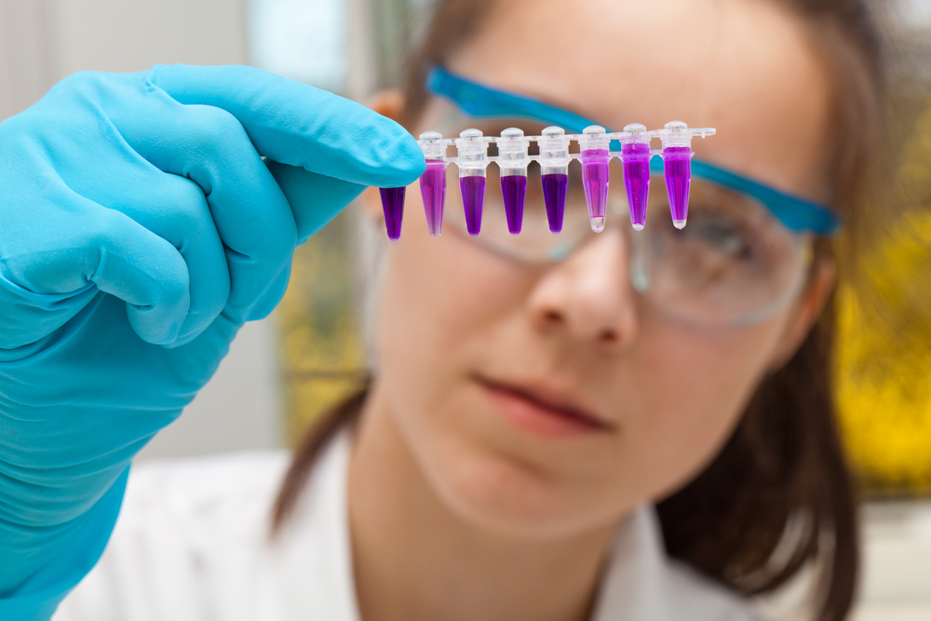
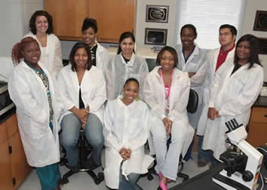
Medical laboratory Technology (MLT)
2 Year AAS Degree Program
Admission Requirements
18 ACT score (15 if taken before October 28, 1989) for first time freshman with not college credit hours
16 ACT score (12 if taken before October 28, 1989) with 12 hours college credit (course approved) and a 2.5 GPA for currently enrolled college students
Entrance Test within 18 months of application deadline. Can only be taken 3 times 30 days apart during the application year if you submit testing taken at any other time the score will not be accepted
Must be 18 years of age prior to the start of the program
Application Period-November - April 1st
Medical Laboratory Technicians (MLT) work together with Medical Technologist (MT) and Pathologist (MD) in the laboratory to solve the mysteries, put the puzzles together, and answer the critical questions of medicine. Seventy to eighty percent of medical decisions made by physicians are based on laboratory findings. Graduates of the program are awarded an Associate of Applied Science degree and are eligible to write for a national certification exam.

Slide 6

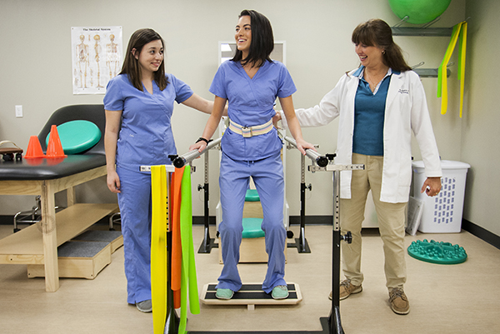
Physical Therapy Assistant
Candidate for Accreditation status
2 Year AAS Degree Program (Beginning August 2020)
Admission Requirements
18 ACT score (15 if taken before October 28, 1989) for first time freshman with not college credit hours
16 ACT score (12 if taken before October 28, 1989) with 12 hours college credit (course approved) and a 2.5 GPA for currently enrolled college students
Completion of A&P 1 and 2 (lecture and lab) with “C” or better within the last 5 years prior to admission
Entrance Test within 18 months of application deadline. Can only be taken 3 times 30 days apart during the application year if you submit testing taken at any other time the score will not be accepted
Must be 18 years of age prior to the start of the program
Observation hours with a licensed PTA
Application Period-November - March 1st
Candidate for Accreditation is an accreditation status of affiliation with the Commission on Accreditation in Physical Therapy Education that indicates the program may matriculate students in technical/professional courses. Achievement of Candidate for Accreditation status does not assure that the program will be granted Initial Accreditation.
CAPTE element 7.2 Definition of Candidate for Accreditation: Candidate for Accreditation is a pre-accreditation status, awarded prior to enrollment of students in the technical (PTA programs) or professional (PT programs) phase of the program, which indicates that the physical therapy education program is progressing toward accreditation. All credits and degrees earned and issued by a program holding candidacy are considered to be from an accredited program.

Slide 7
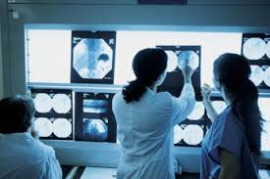
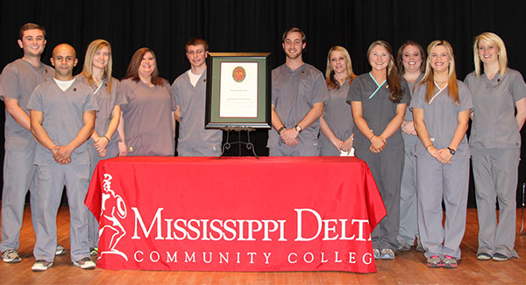
Radiologic Technology
2 Year AAS Degree Program
Admission Requirements
18 ACT score (15 if taken before October 28, 1989) for first time freshman with not college credit hours
16 ACT score (12 if taken before October 28, 1989) with 12 hours college credit (course approved) and a 2.5 GPA for currently enrolled college students
Completion of A&P 1 and 2 (lecture and lab) with “C” or better within the last 5 years prior to admission
Completion of Fundamentals of Radiology with a “C” or better average
Entrance Test within 18 months of application deadline. Can only be taken 3 times 30 days apart during the application year if you submit testing taken at any other time the score will not be accepted
Must be 18 years of age prior to the start of the program
Application Period-November - April 1st
A radiologic technologist (radiographer) is a skilled professional that is qualified to perform imaging examinations and radiologic procedures at the request of physicians. The radiographer functions to ensure consistent radiographic images with minimal exposure to personnel and patients. Graduates of the program are awarded an Associate of Applied Science degree and are eligible to write the American Registry of Radiologic Technology (ARRT) examination.

Slide 8
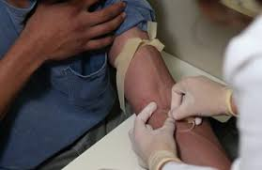
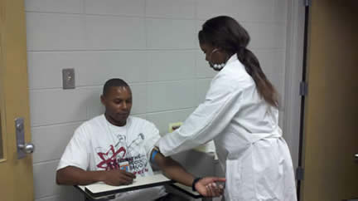
Phlebotomy Technician
1 Semester Certificate Program
Admission Requirements
High School diploma or GED/HiSet
18 ACT score (15 if taken before October 28, 1989) for first time freshman with not college credit hours
16 ACT score (12 if taken before October 28, 1989) with 12 hours college credit (course approved) and a 2.5 GPA for currently enrolled college students
Biology course within the last 5 years (can be High School course)
Must be 18 years of age prior to the start of the program
Application Period
  Fall- May 1st – July 1st
  Spring- Sept. 1st – Nov. 1st
Phlebotomy is the study or art of drawing blood for diagnosing and treating health problems or for blood donation. People who specialize in this study are called phlebotomy technicians. Phlebotomy technicians work in hospitals, clinics, blood banks, clinical laboratories and diagnostic centers. Phlebotomy technicians play an important role in health care. The primary job of a phlebotomy technician is to take blood samples from patients. This evening course is ideal for health professionals seeking to expand their current skills, for currently employed phlebotomists seeking certification, or for those interested in a profession in laboratory medicine.
Great One Semester program to begin your Health Care Career

Slide 9
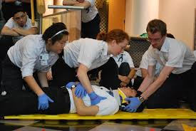
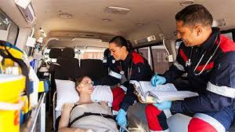
Emergency Medical Technician
Certificate Program
The EMT Program has moved to Workforce.
Please contact the Capps Center for more details on this
Program.
The EMT program provides classroom and laboratory instruction for entry level Emergency Medical Technicians following the current National DOT curriculum. Emergency Medical Technician-Basic is an instructional program that prepares individuals to function in the pre-hospital environment. The EMT-Basic program provides instruction in basic life support care of sick and injured persons. This includes airway assessment, communications, documentation, general pharmacology, hemorrhage control, ambulance operations, and splinting of adult, pediatric, and infant patients; and special care patients exposed to heat, cold, radiation, or contagious disease.
A certificate of completion will be awarded to those who satisfactory complete the EMT curriculum. Upon successful completion of the course, students are eligible to sit for the National Registry for Emergency Medical Technicians Basic Testing.
PRE-REQUISITE: Career Readiness Certificate (CRC), minimum of a silver certificate
Cost: $675
Contact Anjavette Payton, 662-445-1984, for additional information.

Slide 10

Nursing
Associate Degree Nursing
Practical Nursing
Health Care Assistant

Slide 11
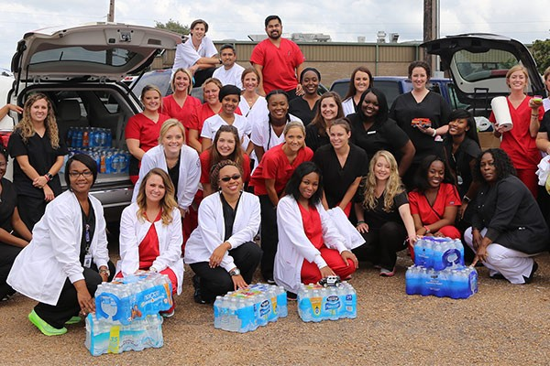
Associate Degree Nursing
2 Year AAS Degree Program
Admission Requirements
18 ACT score (15 if taken before October 28, 1989) for first time freshman with not college credit hours
16 ACT score (12 if taken before October 28, 1989) with 12 hours college credit (course approved) and a 2.5 GPA for currently enrolled college students
Completion of A&P 1 and 2 (lecture and lab) with “C” or better within the last 5 years prior to admission
Entrance Test within 18 months of application deadline. Can only be taken 3 times 30 days apart during the application year if you submit testing taken at any other time the score will not be accepted
Must be 18 years of age prior to the start of the program
Application Period-November- March 1st
The Associate Degree Nursing Program prepares nurses at the basic level of entry for professional nursing practice. The curriculum is designed to prepare graduates to practice safe, effective nursing and function as team members after passing the National Council Licensing Examination for RNs (NCLEX-RN®). A registered nurse means that a person has graduated from an approved nursing program, passed the NCLEX-RN® examination, and is licensed by the state. The nurse practices within the legal and ethical rules and regulations established by the Mississippi Board of Nursing as determined by the Mississippi Nursing Practice Law (Nurse Practice Act).

Slide 12
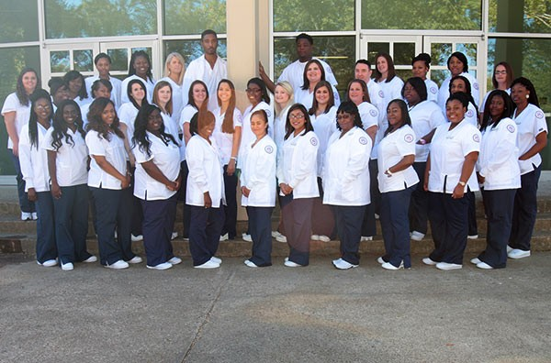
Practical Nursing
1 Year Certificate Program
Admission Requirements
16 ACT score (12 if taken before October 28, 1989)
Entrance Test within 18 months of application deadline
Must be 18 years of age prior to the start of the program
Application Period-November- April 1st
The MDCC Practical Nursing (PN) Program is a three-semester program that prepares graduates with the knowledge and skills needed to meet the expanding health care needs of the community. Graduates of the program are awarded a certificate and are eligible to write the National Council Licensure Examination for Practical Nurses (NCLEX-PN®). Graduates must apply to the Mississippi Board of Nursing for licensure to practice as a Licensed Practical Nurse in the State of Mississippi.

Slide 13
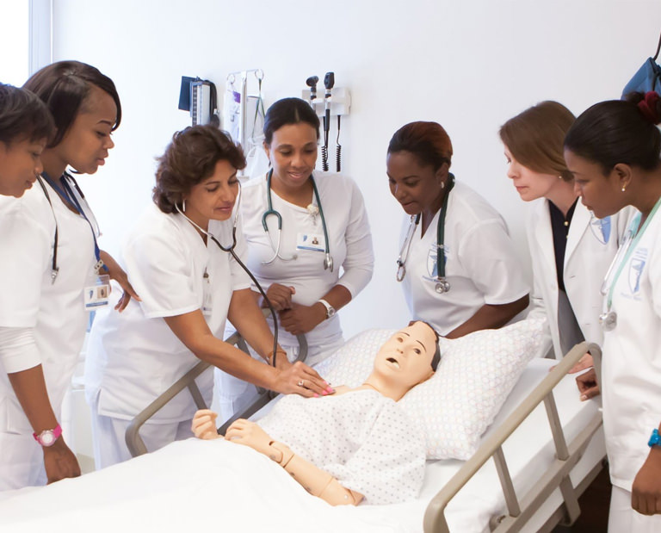
Health Care Assistant
1 Semester Certificate Program
Classes are held at GHEC (Greenville) and Golden Age Nursing Home (Greenwood)
Admission Requirements
be a high school graduate or have a satisfactory High School Equivalency score (GED or HiSET) OR be currently enrolled in the MDCC MiBest program
14 ACT score(9 or 10 if taken before October 28, 1989) or 14 Accuplacer score
Must be 18 years of age prior to the start of the program
Application Period
  Fall- May 1st – July 1st
  Spring- Sept. 1st – Nov. 1st
  *The Health Care Assistant program at MDCC may allow up to 15% admission for high-risk students (students who do not meet admission criteria).
The Health Care Assistant program prepares the individual to assist in providing health care as a member of the health care team under the direction of a health care professional. The health care assistant works under the supervision of RN's, LPN's, and other medical personnel. The assistant may work in a variety of settings including, but not limited to, nursing homes or long term care, personal care facilities, hospitals, home health agencies, and private homes. Upon successful completion of the curriculum, students are eligible to sit for the National Nurse Aide Assessment Program Examination.
Great One Semester program to Start Your Nursing Career

Slide 14
Health Science Programs
Student Activities

Slide 15
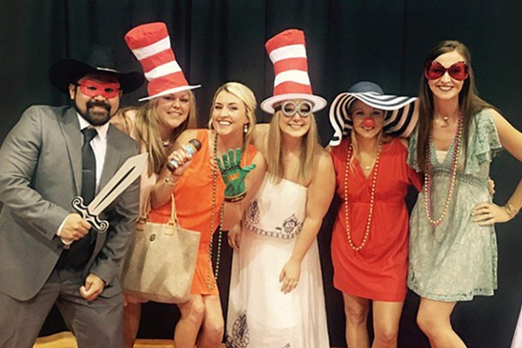
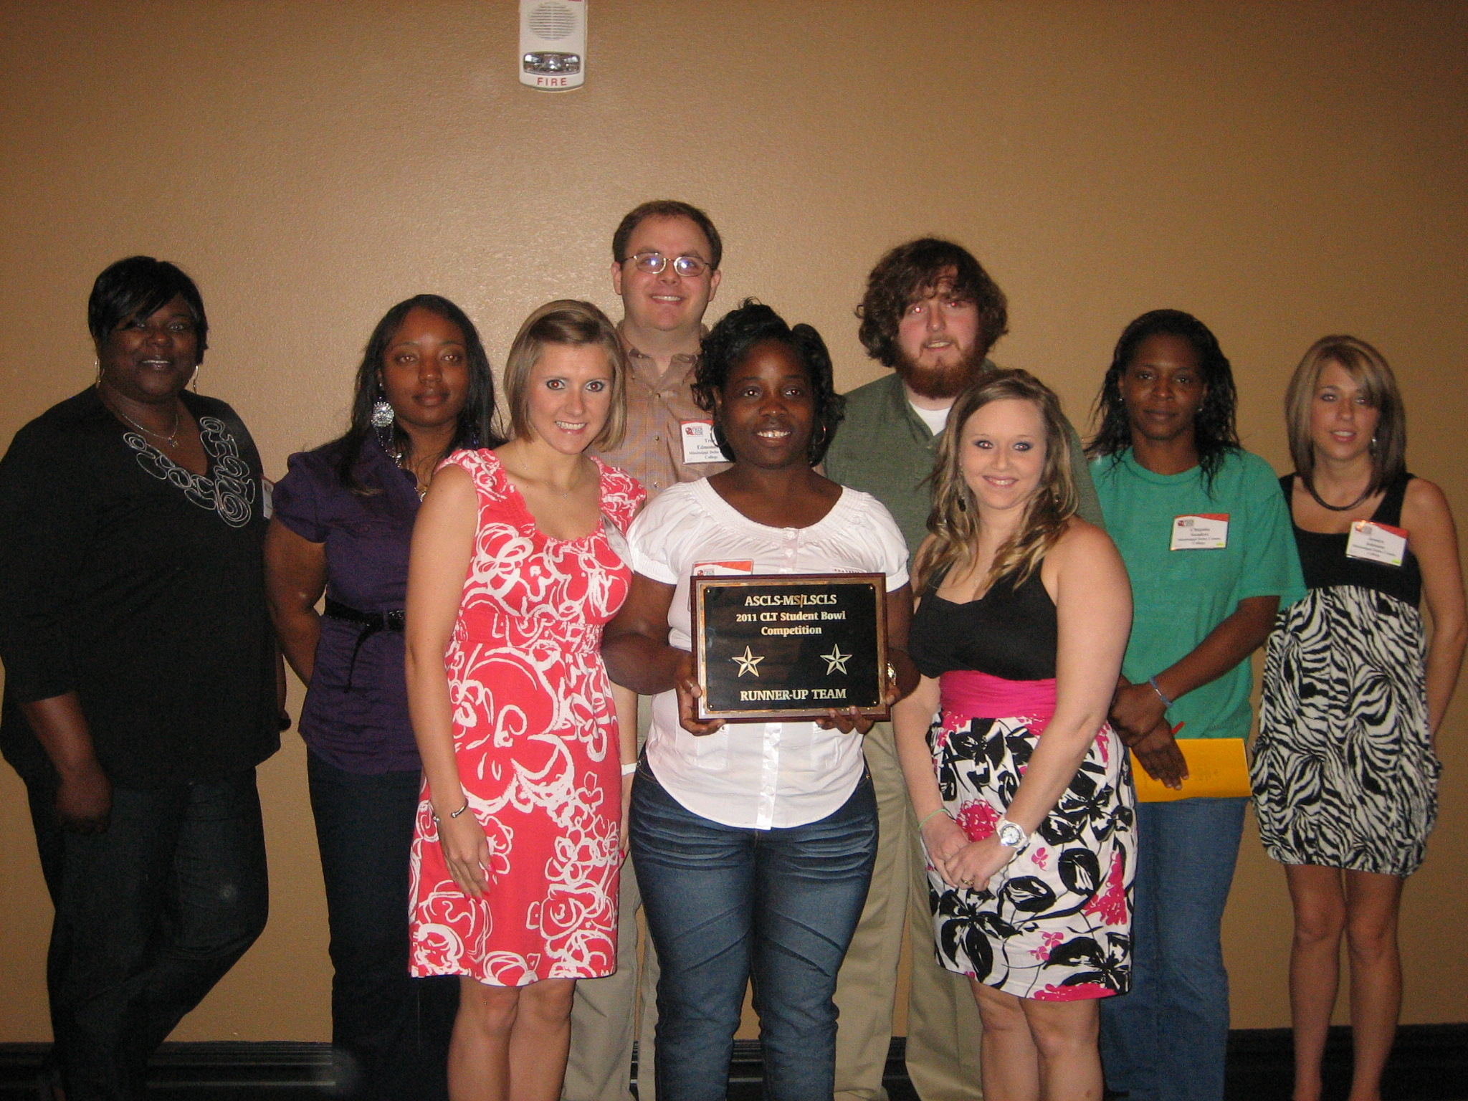
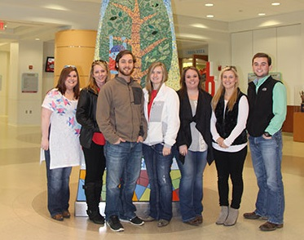
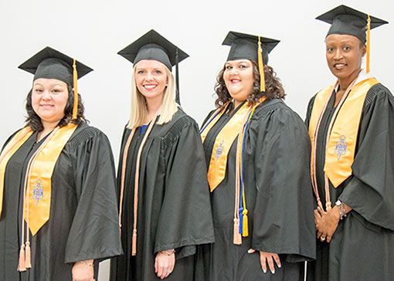
MDCC Student Clubs
Health Science Clubs
Associate Degree Nursing Club (MOSA)
  Alpha Delta Nu Nursing Honor Society
Mississippi Practical Nursing Student Nurse Organization
American Society for Clinical Laboratory Science (ASCLS-MS)
Student American Dental Hygienists Association (SADHA)
X-Ray Club
  Lambda Nu Honor Society
MDCC Health Science programs provide students with not only an academic environment but also an opportunity to grow and develop within their chosen profession. Student clubs and honor societies offer students: networking opportunities, professional contacts, discussion forms, community service and scholarship opportunities.

Slide 16
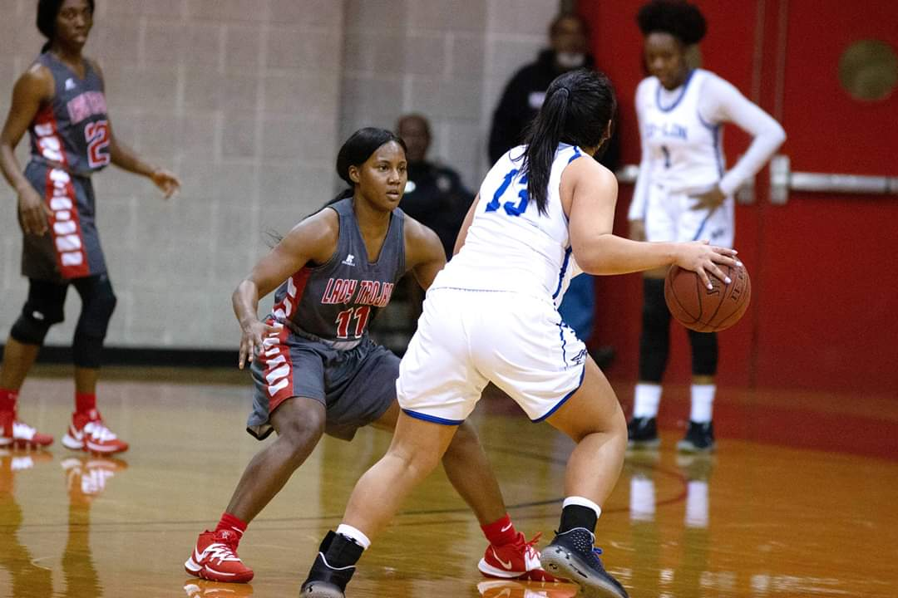



Student Life
MDCC offers the full college experience
Student housing
Financial Aid Services
Library
Student Success Center
  Tutoring
  Mentoring
  Counseling and Advising
  Cultural Activities
Student Union
Student Government Association
Athletics
Bookstore
Disability Services
Alumni and Foundation

Slide 17
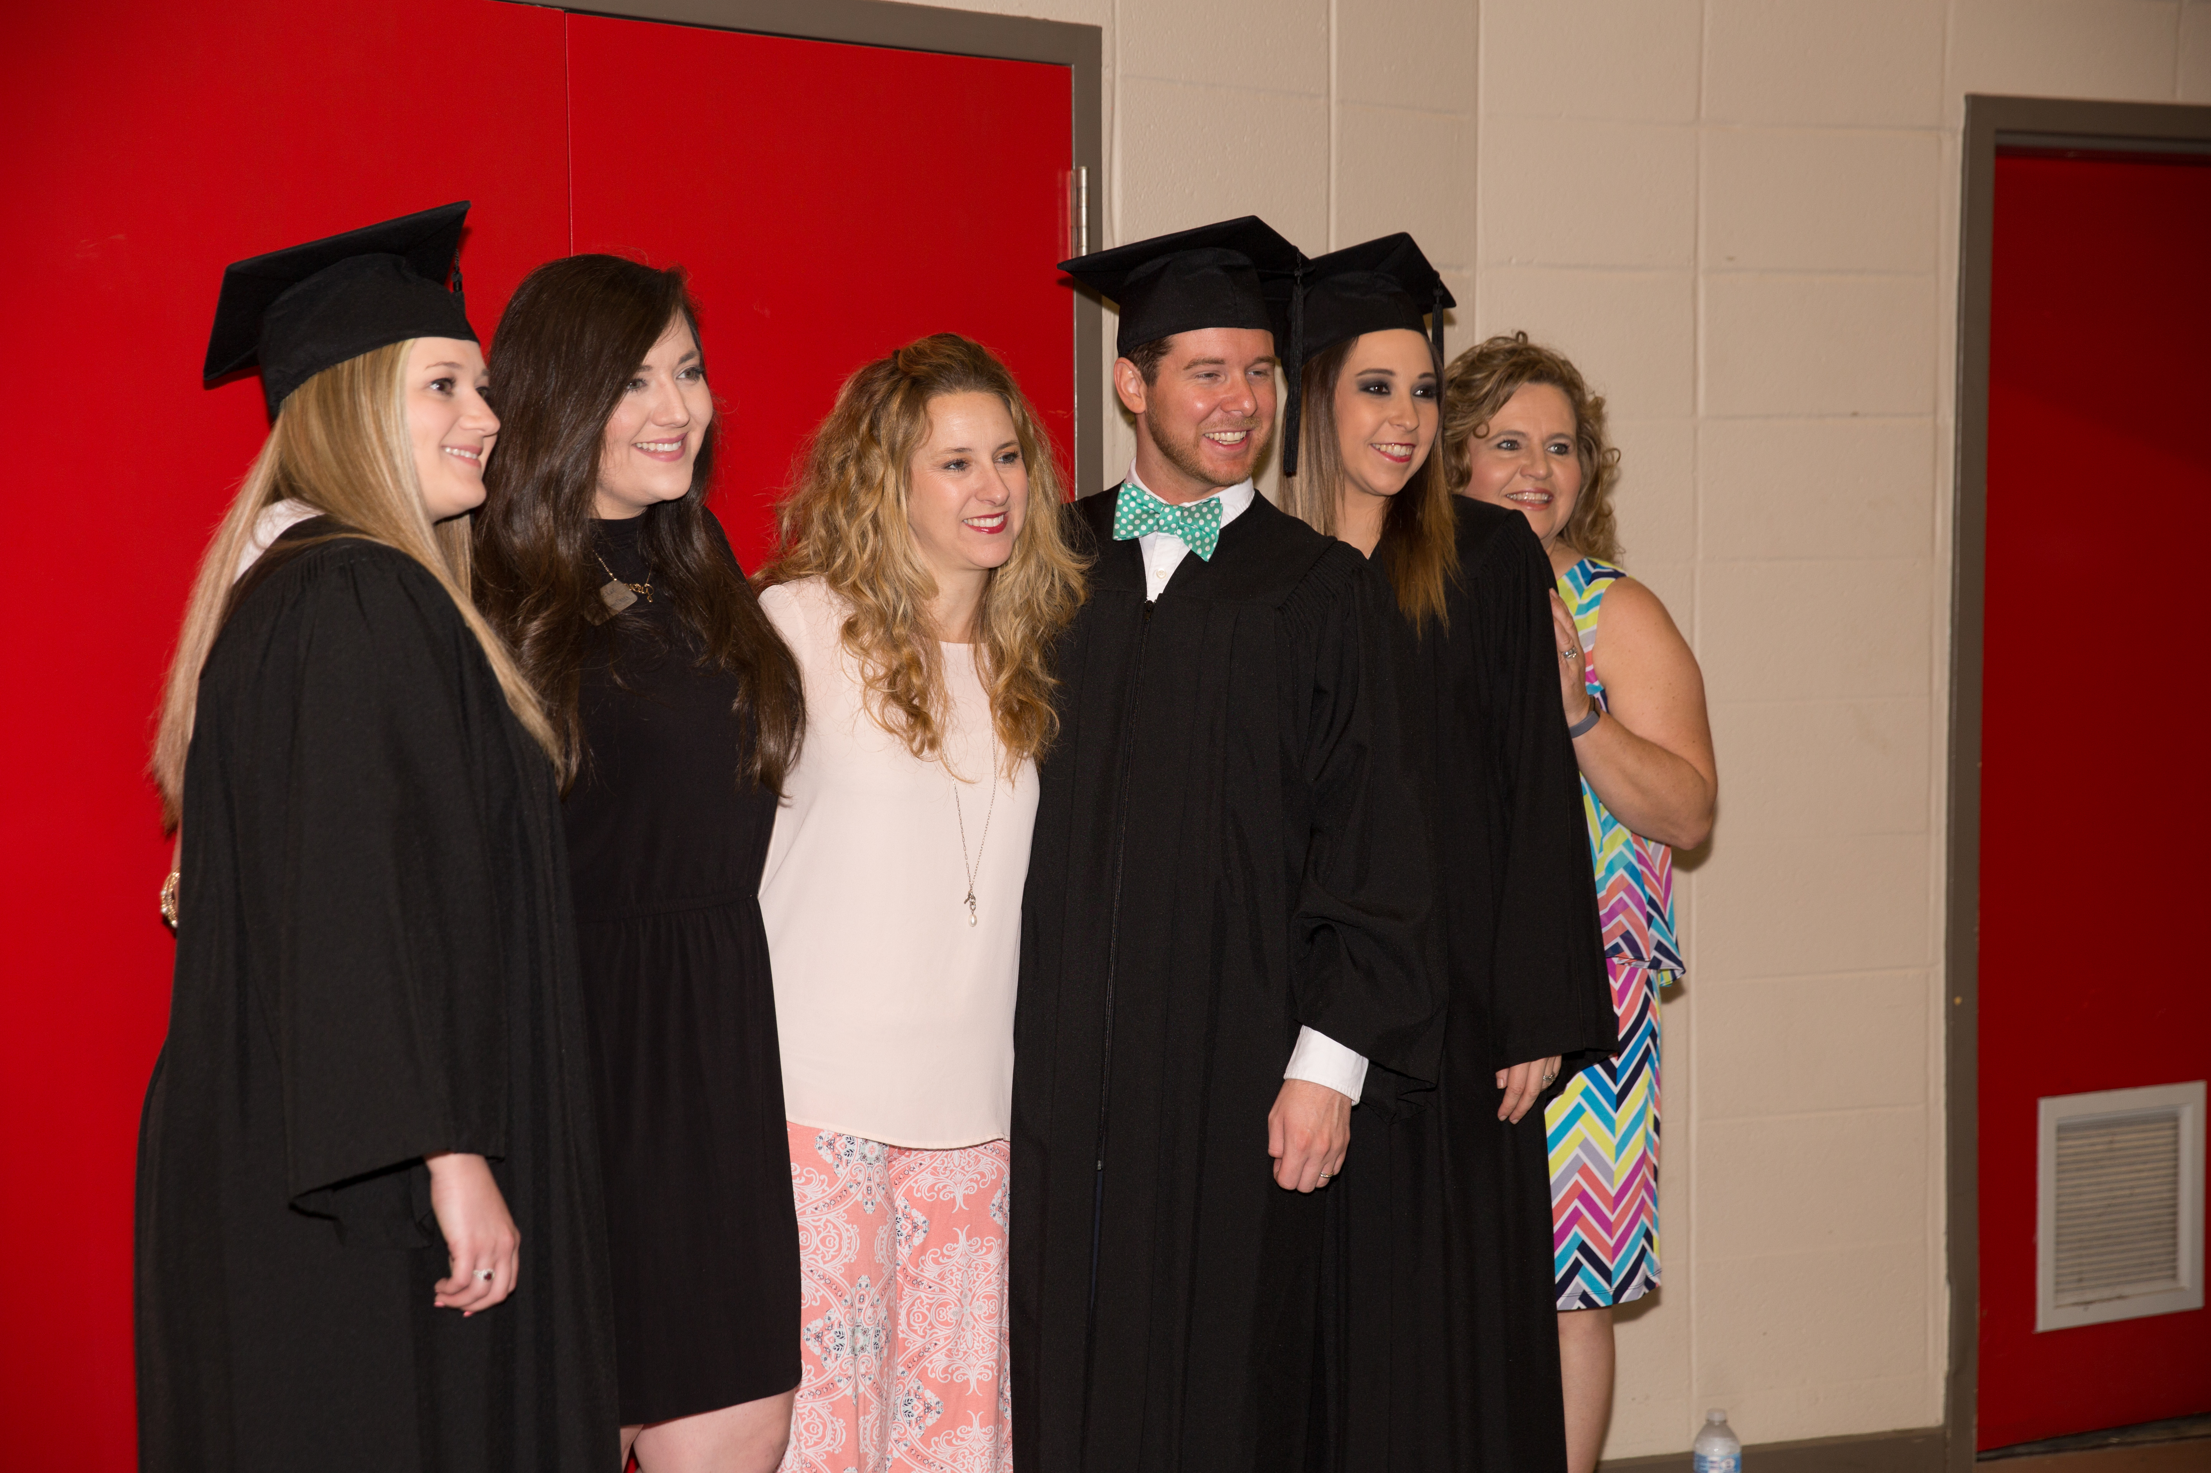
Health Science
Applications

Slide 18
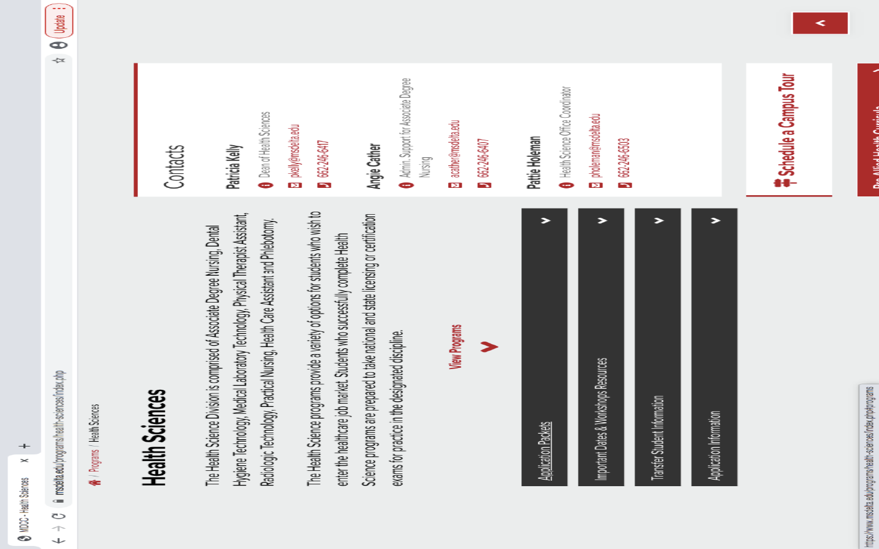
Application Deadlines
March 1st
Associate Degree Nursing
Dental Hygiene Technology
Physical Therapist Assistant
April 1st
Practical Nursing
Medical Laboratory Technology
Radiologic Technology
HCA and Phlebotomy
  Fall-July 1st
  Spring- Nov. 1st
Visit the MDCC website at www.msdelta.edu to apply for college admission and obtain your application packet

Slide 19
First apply for MDCC general admission

Slide 20
Apply for Admission or Readmission or Transfer Student

Slide 21
Deadlines and Minimum Requirements To Apply will be indicated in each application
NOTE: Incomplete applications will not be reviewed for admission into the program!
Example provided is from the PTA application
Please Note the new TEAS Requirements

Slide 22
ACT, Transcripts, TEAS Test
Each program will have set due dates
Example provided is from the PTA application
Note the new statement on age requirement and TEAS testing

Slide 23
Associate Degree Nursing Applications:
Angela Bell-Alexander
Division of ADN
Mississippi Delta Community College
P O Box 668
Moorhead, MS 38761
Mail your application to address listed on Page 1!
All other Health Science Programs:
Pattie Holeman
Division of Allied Health
Mississippi Delta Community College
P O Box 668
Moorhead, MS 38761
ACCEPTANCE LETTERS WILL BE SENT AS INDICATED IN THE SELECTION PROCESS SECTION
Example provided is from the Dental Hygiene
application

Slide 24
Selection Process:
If accepted into the program, a list of what will be expected of you is provided here and in your acceptance letter. Pleases note each programs’ requirements are different.
Example provided is from the ADN application

Slide 25
Programs requiring A&P or other
academic courses prior
to admission:
This means prior to start of the
Program NOT prior to application.
However, it is highly encouraged to
begin working on these
requirements as early as possible.
CPR, Background Check, and
Drug Screen will be performed
by MDCC if you are accepted into
the program. Information will be
provided in the acceptance letter.
Example provided is from the PTA application

Slide 26
Health form, vaccination
requirement, and orientation
information will be included
in acceptance letter. A Form 121
Immunization Record is
required. This information is not
required as part of the application process.

Slide 27
Application includes a policy of
acceptance of transfer students.
Each program has unique standards
pertaining to transfer of credit hours.
Example provided is from the ADN application

Slide 28
Rating Scale For Admission
Each program utilizes an objective rating
scale during the selection process.
This scale can be found in the application.
Example provided is from the PTA application

Slide 29
Rating Scale For Admission
GPA is calculated using academic course work approved
by the program and based on a minimum of 12 hours.
The courses utilized are found on the program’s check sheet.
Check Sheets can be found on the program’s web-site
Example from MLT

Slide 30
The Application
Complete all information. We need current address, phone number, and email to keep in contact with you.
Example provided is from the ADN application

Slide 31
If you plan to retake the ACT before the application deadline, please tell us here!
ACT scores are NOT printed on transcripts, so you will need to provide us with a copy!
Please let us know if you are currently enrolled at MDCC!
Example provided is from the ADN application

Slide 32
Please review the:
Substance Use Policy
Background Information Policy
Core Performance Standards/Minimum Technical Standards for each program
Example provided is from
the ADN application

Slide 33
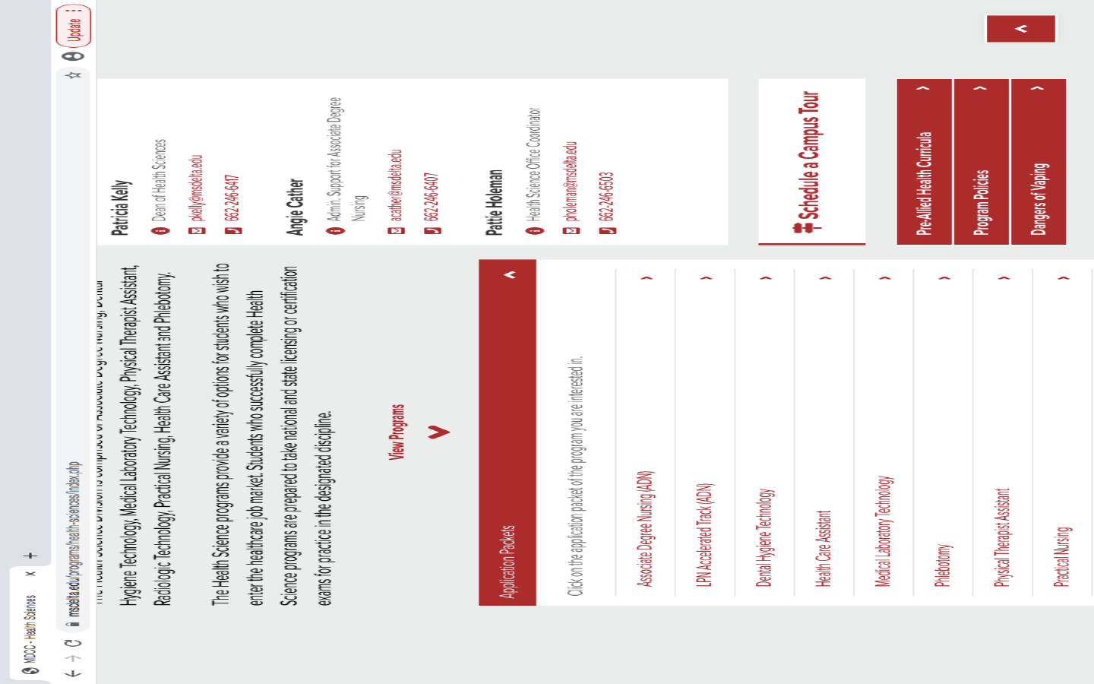
Drug Screen, Background Check,
General : Admission,
Readmission, and Transfer
Policy can be found on the
Health Sciences’ Home page
under ‘Program Policies’

Slide 34
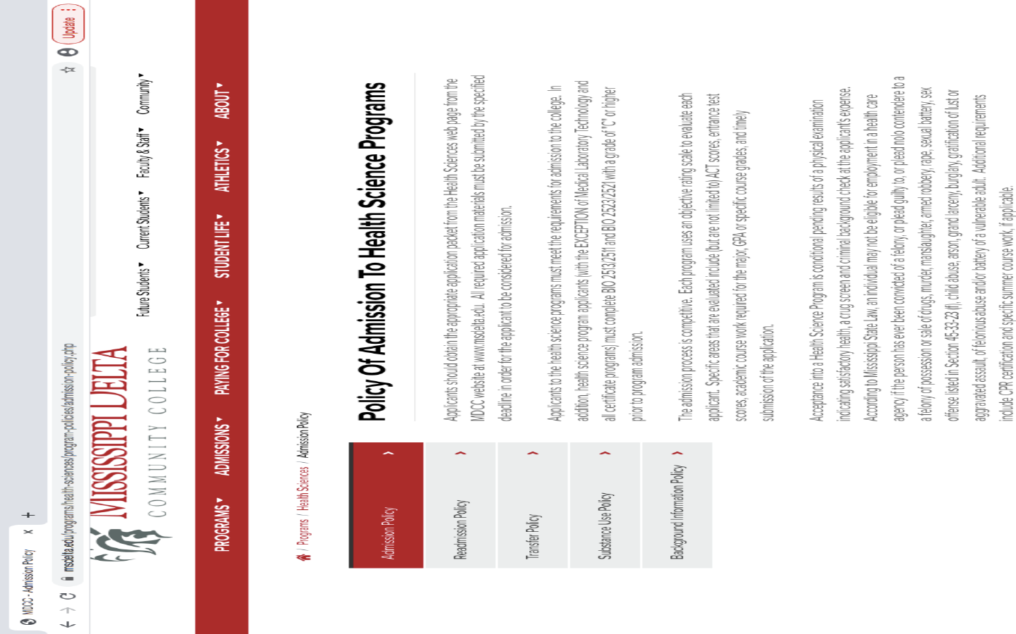
Program
Policies

Slide 35
Core Performance Standards / Minimum Technical Standards are different for each program.
These can be found on each programs’
Website page and are included in the application
Example provided is
from the ADN application

Slide 36
YES
NO
1.
Do you understand that if accepted into the
Physical T
herapist
Assistant
Program you will
be required to undergo a pre
-
admission drug screening performed by our office?
YES
NO
2.
**See our Substance Use Po
licy found on our website**
Do you understand that if accepted into the
Physical Therapist
Assistant
Program you will
be required to be fingerprinted by our office for a Healthcare Criminal History background
check?
**See our Background Informatio
n Policy found on our website**
YES
NO
3.
Do you understand the
technical standards
that are considered essential for the practice of
Please read the concluding
statement carefully and
you MUST sign Your Application
physical therapy assistant
listed below?
These include:
communication standards,
cognitive and intellectual standards, mob
ility/motor skills, sensory abilities and
observational skills, and behavioral/professional standards.
**See our
Minimum Technica
l Standards for Physical Therapist
Assistant
**
ALL APPLICANTS SHOULD BE ADVISED OF THE FOLLOWING:
1.
Any statements made on th
is application which
time of making such statement
are
false and known to be false by the applicant at the
s
, shall be deemed fraudulent and subjects the applicant to disciplinary
2.
proceedings.
According to Mississippi State Law, an individual may not be eli
gible for employment in a health care
agency if the person has ever been convicted of a felony , or plead guilty to , or plead nolo contendere to
a felony of possession or sale of drugs, murder, manslaughter, armed robbery, rape, sexual battery, sex
offens
e listed in Section 45
-
33
-
23 (f), child abuse, arson, grand larceny, burglary, gratification of lust or
aggravated assault, of felonious abuse and/or battery of a vulnerable adult.
I certify that the information
on this application is true and accurate.
_____________________________________________
____________________________
Applicant Signature
Date
Example provided is
from the PTA application
,

Slide 37
Each Program application
provides a cost Estimate
This is an ESTIMATE
Example provided is
from the PN application

Slide 38
Step by Step Instructions for Registering for the TEAS test is found on the last page.
ALL TEAS testing will be offered
Virtually. If you cannot meet the technical
requirements listed, please contact our office
to make alternate arrangements for testing.
Pattie Holeman at pholeman@msdelta.edu
The TEAS can now be taken on any date
proctored by ATI. BUT it cannot be taken an
unlimited amount of times: It can be taken
3 times 30 days apart in the application year
(August 2021-May 2022). We will accept
a previous TEAS if you tested within the last
18 months

Slide 39
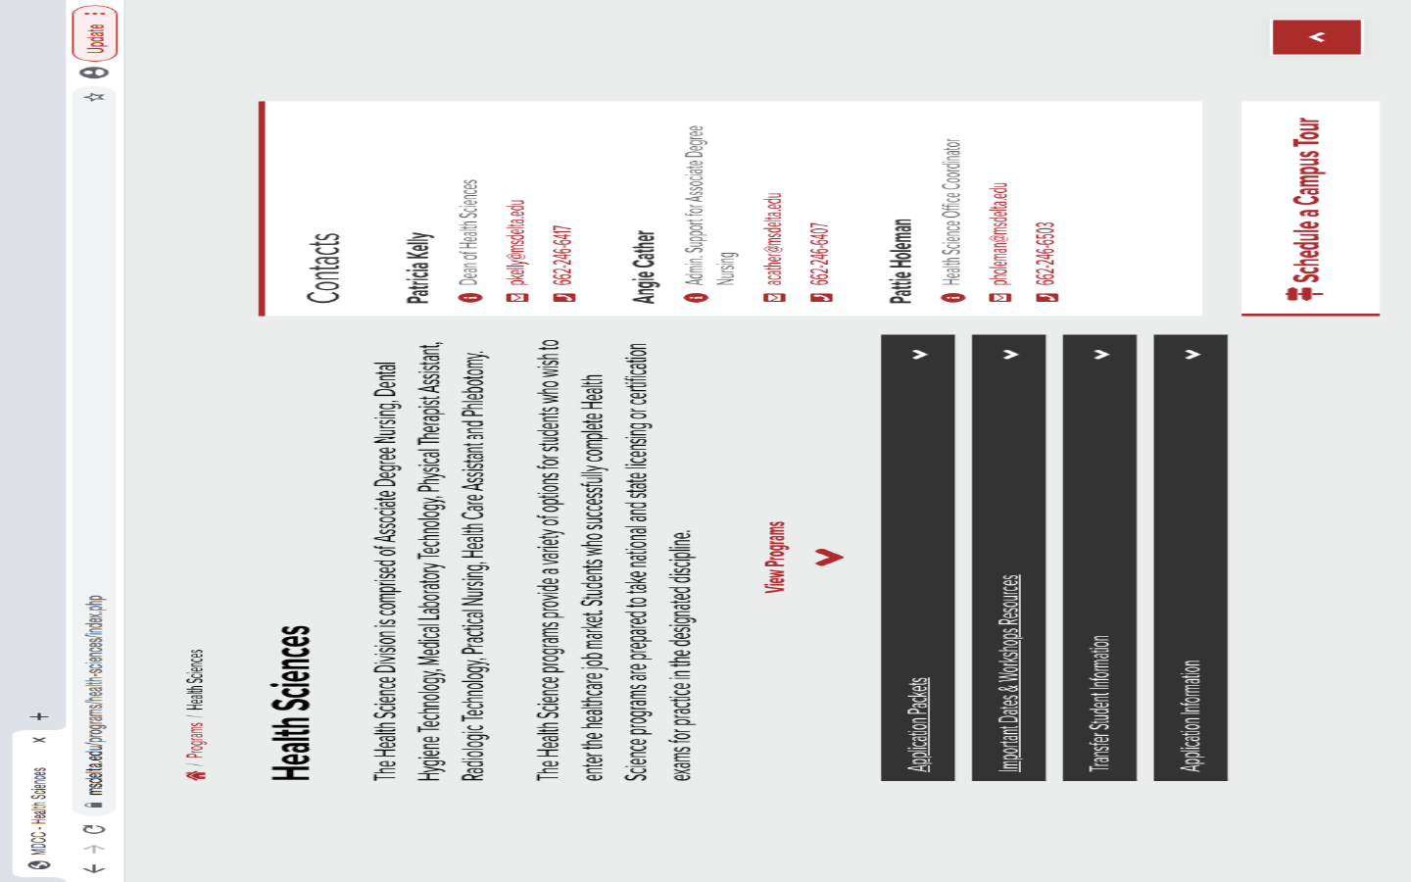
Information on TEAS Testing
Can be found on the Health
Sciences’ main web page under
‘Important Dates & Workshop Resources’

Slide 40
All TEAS Exams will be Remote Proctored (Virtual). You must meet certain technical requirements to take this exam remotely. Please ensure that you are able to meet the following technical requirements:
Microphone: Any microphone, either internal or external
Webcam: 320x240 VGA resolution (minimum), internal or external
Desktop or laptop computer - NO iPads, tablets, or phones are to be used
Google Chrome web browser
The TEAS can now be taken on any date
proctored by ATI. BUT it cannot be taken an
unlimited amount of times: It can be taken
3 times 30 days apart in the application year
(August 2021-May 2022). We will accept
a previous TEAS if you tested within the last
18 months
The cost of the TEAS test is $115.00 and is payable only by debit or credit card at the time you register. The last day to register is 72 hours before your desired test date.
If you are unable to meet the technology requirement please contact Pattie Holeman at pholeman@msdelta.edu
To register for testing, please visit www.atitesting.com.

Slide 41
DHT Program ‘s hours of observation

Slide 42
PTA Program required hours of observation time.

Slide 43
Must complete Autobiographical Form to apply for PTA program.

Slide 44
If you have any question on a particular program’s
requirements of admission and/or application
Please visit the program’s website –
You will find contact information on each program’s home page.
We look forward to having you apply to our Health Science Programs
In compliance with Title VI and Title VII of the Civil Rights Act of 1964, Title IX of the Education Amendments of 1972 of the Higher Education Act, Section 504 of the Rehabilitation Act of 1973, the Americans with Disabilities Act of 1990, the Pregnancy Discrimination Act of 1978 and other applicable Federal and State Acts, Mississippi Delta Community College offers equal education and employment opportunities and does not discriminate on the basis of age, race, color, national origin, religion, sex, sexual orientation, gender identity or expression, physical or mental disability, pregnancy, or veteran status in its educational programs and activities or in its employment practices. The following have been designated to handle inquiries regarding these policies: EEOC Compliance/Non-Discrimination: Dr. Steven J. Jones, Vice President of Administrative Services; 662.246.6304 or EEOC@msdelta.edu. Title IX: Mr. Derrick Fields, Dean of Student Services, 662.246.6444 or titleIX@msdelta.edu. Disability Support Services: Ms. Nakeshia Fipps, Counseling and Disability Support Services Coordinator, 662.246.6361 or ADAcompliance@msdelta.edu. The mailing address for the above-named representatives is P.O. Box 668, Moorhead, MS 38761.

